Slide 1
Conversational AI: Build NLU model using LUIS
By Mansi Jain
Alpha Microsoft Learn Student Ambassador

Slide 2

Speaker for today’s session
Computer Science Undergrad at ASET, Noida.
Alpha Microsoft Learn Student Ambassador.
Mansi Jain

Slide 3
Topics To Be Discussed
What is Conversational AI?
What is NLU (Natural Language Understanding)?
- Dialogues
- Utterances
- Intents
- Entities
What is LUIS (Language Understanding)?
Demonstration for building NLU model using LUIS.

Slide 4

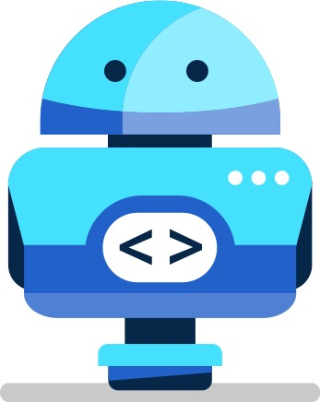
What is Conversational AI?
Conversational AI is a subfield of artificial intelligence focused on producing natural and seamless conversations between humans and computers.
A new user interface paradigm.
Exposes software services through conversational interface.
In apps, browser and on IoT devices.

Slide 5
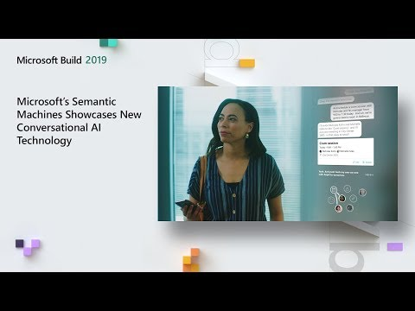

Slide 6
What is Natural Language Understanding (NLU)?
NLU directly enables Human-Computer Interaction (HCI) in the form of dialogues/conversations.
- Enables computers to understand commands without the formalized syntax of computer languages
- Enables computers to communicate back to humans in their own languages.
NLU is tasked with communicating with untrained individuals and understanding their intent, and entities meaning that NLU goes beyond understanding words and interprets meaning.
NLU should be programmed with the ability to understand meaning despite common human errors like mispronunciations or transposed letters or words.

Slide 7
Dialogues
Task-Oriented Dialogue
“User has a question”: User needs to consume Information
What is today’s agenda?
What does MSFT stand for?
“User needs to get something done”: User needs to complete some task
Book me a flight from Cairo to Seattle
Reserve me a table at The Kitchen for 5 people at 7 pm
“User need to know what to do”: User needs decision support
Is the Build conference good to attend?
Open-Domain Dialogue
“User wants to chit-chat”: User wants to talk like a human

Slide 8
Utterances: How will users ask for something?
Utterances are input from the user that your app needs to interpret.
To train LUIS to extract intents and entities from them, it's important to capture a variety of different example utterances for each intent.
Active learning, or the process of continuing to train on new utterances, is essential to machine-learning intelligence that LUIS provides.
Example utterances
- How do I get a computer?
- Where do I get a computer?
- I want to get a computer, how do I go about it?
- When can I have a computer?
What good utterances are - http://bit.ly/utterances
Notes:
Utterances-Utterances are pure NLP training. As we discussed before, there are multiple ways to say one single thing.
Our bot can tell user where the store is located, but for the NLP application to tell us what is the user’s intent, we first need to give it examples of how the user could ask for it. To do so, we will simply input a range of utterances (sentences) that mean the same thing, « I want to get the store’s location », and tell the NLP application that these utterances mean the user wants to know where is located the store. After a proper NLP training process, based on your utterances, your NLP application will be able to tell you what the user wants to say.

Slide 9
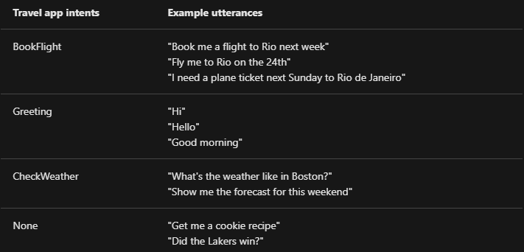
Intents: What does the user want to say?
An intent represents a task or action the user wants to perform. It is a purpose or goal expressed in a user's utterance.
E.g. greeting, confirmation, request a vacation, place an order, delete an email etc.
Intents -> Actions users want to take in your application

Slide 10
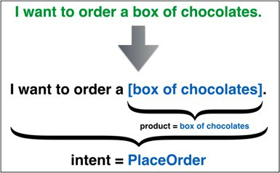
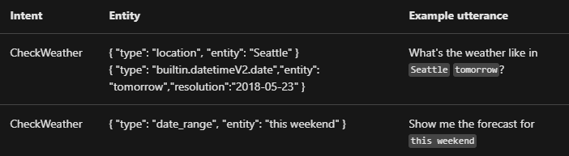
Entities: What information did the user give?
The intent represents action the application should take for the user and is based on the entire utterance. An utterance can have only one top scoring intent but it can have many entities.
Entities -> Represent parameters required to execute the action.
Flights from Cairo to Seattle Today
OriginCity
DestinationCity
Date

Slide 11


LUIS (Language Understanding)
LUIS (Language Understanding)- Cognitive Service, Microsoft.
LUIS is a cloud-based conversational AI service that applies custom machine-learning intelligence to a user's conversational, natural language text to predict overall meaning, and pull out relevant, detailed information.
It provides access through its custom portal, APIs and SDK client libraries.

Slide 12
What does LUIS Offer?
Simplicity: LUIS offloads you from the need of in-house AI expertise or any prior machine learning knowledge. With only a few clicks you can build your own conversational AI application. You can build your custom application by following one of our quickstarts, or you can use one of our prebuilt domain apps.
Security, Privacy and Compliance: Backed by Azure infrastructure, LUIS offers enterprise-grade security, privacy, and compliance. Your data remains yours; you can delete your data at any time. Your data is encrypted while it’s in storage. Learn more about this here.
Integration: easily integrate your LUIS app with other Microsoft services like Microsoft Bot framework, QnA Maker, and Speech service.

Slide 13
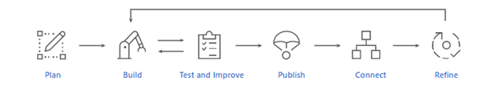
Application Development life cycle
Plan: Identify the scenarios that users might use your application for. Define the actions and relevant information that needs to be recognized.
Build: Use your authoring resource to develop your app. Start by defining intents and entities. Then, add training utterances for each intent.
Test and Improve: Start testing your model with other utterances to get a sense of how the app behaves, and you can decide if any improvement is needed. You can improve your application by following these best practices.
Publish: Deploy your app for prediction and query the endpoint using your prediction resource. Learn more about authoring and prediction resources here.
Connect: Connect to other services such as Microsoft Bot framework, QnA Maker, and Speech service.
Refine: Review endpoint utterances to improve your application with real life examples.

Slide 14

Application Development life cycle
Your LUIS Application
Your Service
“Find me a wireless mouse at $30”
Intent -> Find an item
Item -> wireless mouse
Money -> $30

